Slide 1

Blockchain Based Crime Reporting Application
By Team Binary Shadows

Slide 2
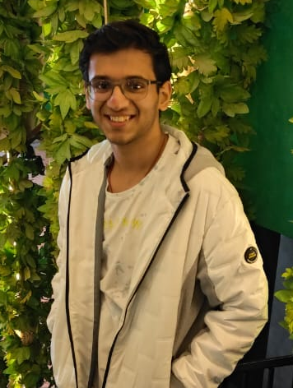

About Us
We are a dynamic team of second-year students from Bennett University, Greater Noida. Fuelled by our shared passion for technology and societal impact, we're developing a crime reporting decentralized application (DApp). Our diverse team brings unique skills to the table, and as we navigate our second year, we're committed to leveraging decentralized technology for a safer society. Join us on this exciting journey at the intersection of innovation and social change.
Team Leader
Contract Developer
Front-end Developer
React.js

Slide 3

Problem
The problem that has inspired this problem statement is the challenge of ensuring public safety through reporting crimes while addressing concerns related to privacy, security, and fear of retaliation. Traditional methods of reporting crimes may not always guarantee anonymity for individuals providing information. In some cases, people might hesitate to come forward due to fear of retribution or concerns about the security of their identity.

Slide 4
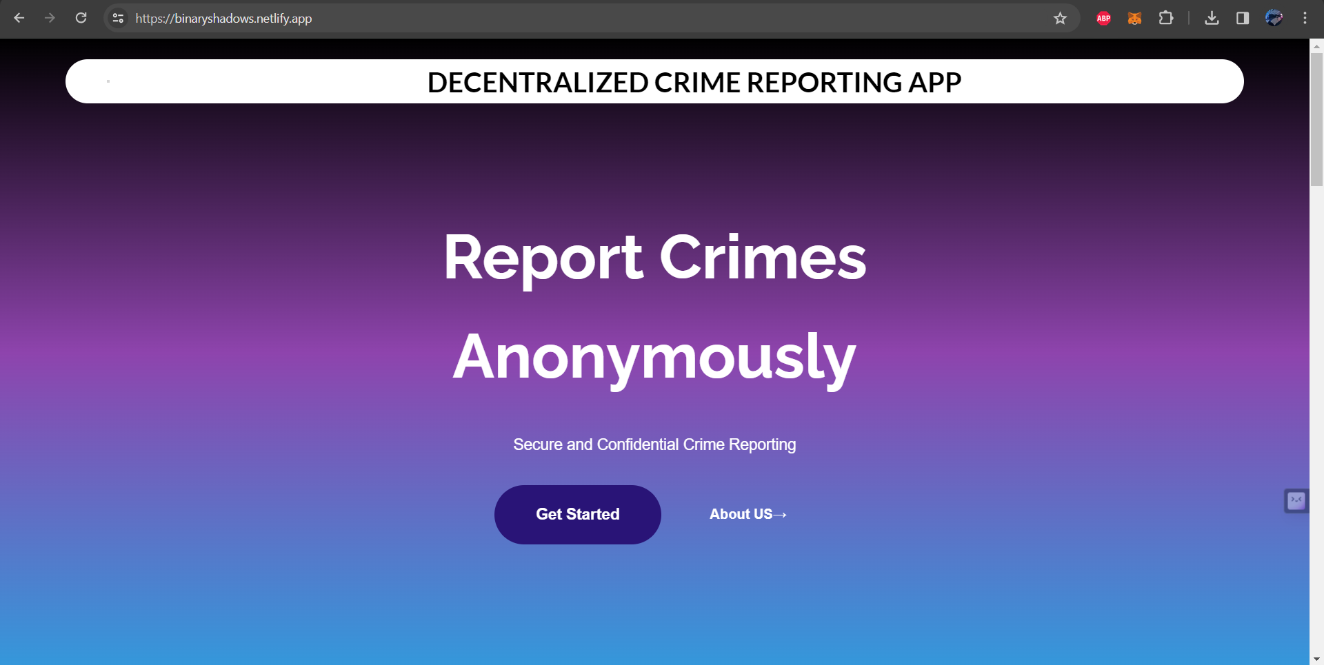
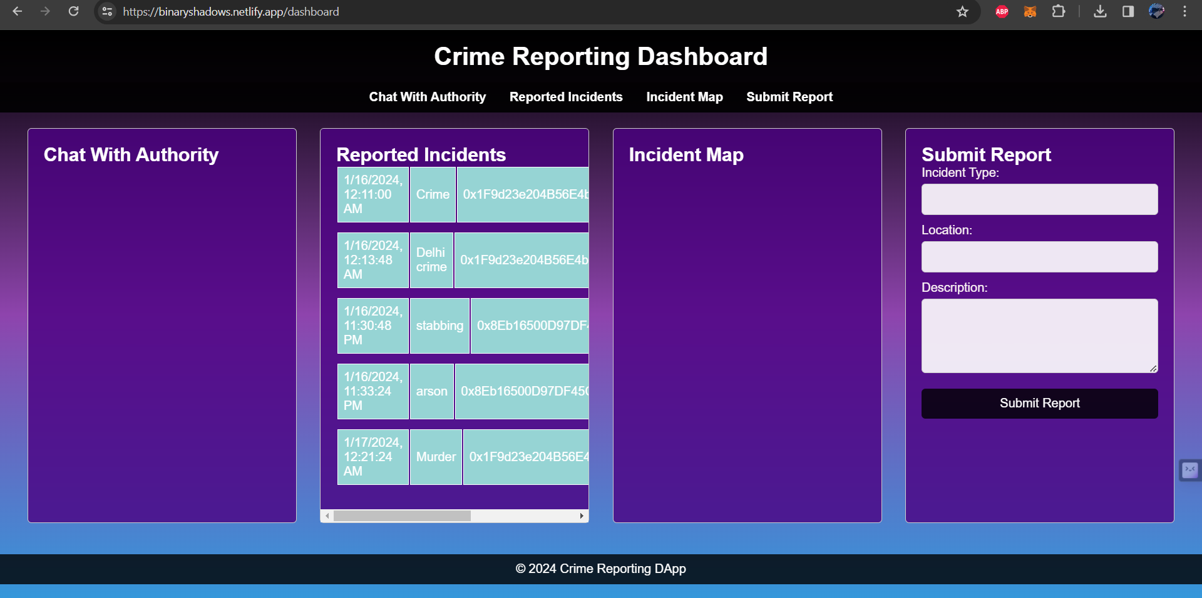
Solution We Made
Developing a decentralized application on a blockchain platform that allows users to anonymously report crimes. The goal is to create a secure, transparent, and trust worthy system that empowers individuals to contribute to public safety without fear of retaliation.

Slide 5


Technology Used
Solidity Language:
Developing Contracts For Ethereum Blockchain
Hardhat Environment:
For Testing and Deploying Of Smart Contract

Slide 6

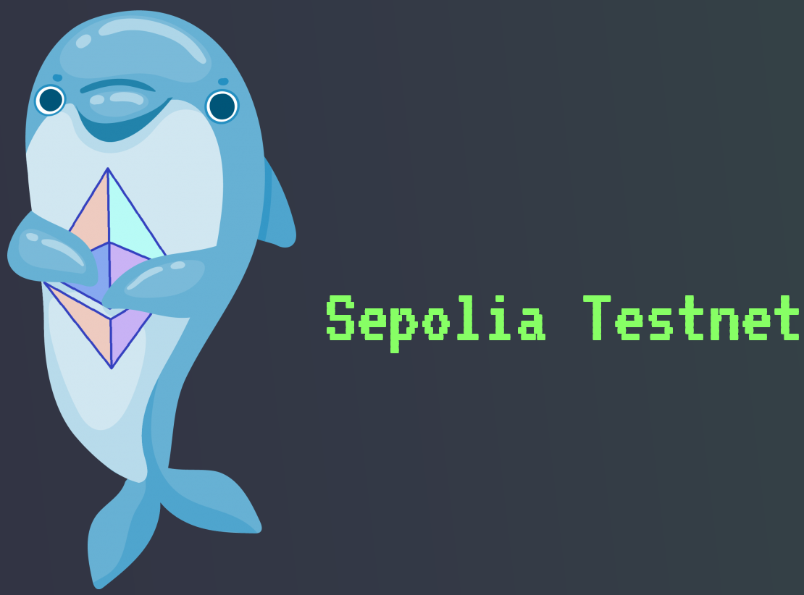

MetaMask Wallet:
To Sign Transactions onto the Blockchain
Sepolia Test net:
To Deploy the Smart Contract
React.Js:
For the Frontend Part of the Project

Slide 7
Future Aspects
Anonymous Chats with Police Department
Community Forums and Discussions
Maps Integration for Area wise Crime Rate Analysis
Reward System for Accurate Crime Reporting

Slide 8


